Slide 1

Fostering empathy in online communities
Muhammad Hamza Ali | Ibrahim Siraj Pasha | Jessica Hösl | Jeremiah Agboola
START Hack 2022 | Case SUPERCELL

Slide 2
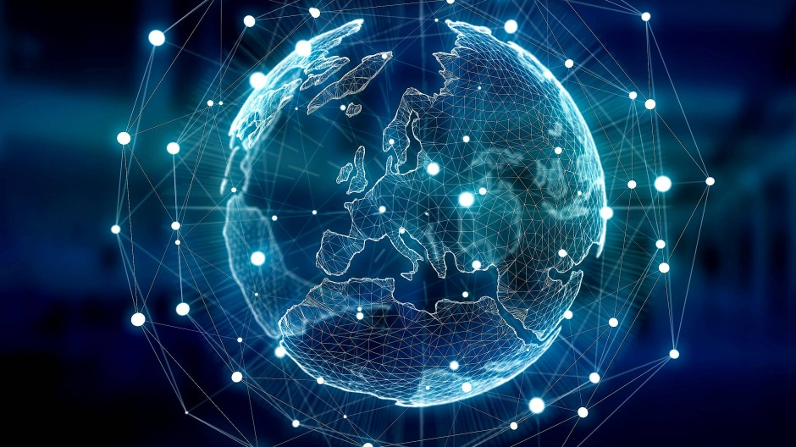
3.89 Billion
People using internet in 2020.

Slide 3

44%
Estimated victims of cyberbullying.

Slide 4
Reasons
Dissociation between internet and real identities
Unavailable reactions and expression of the members
Unstructured communities to shape interactions
Lack of lasting consequences

Slide 5
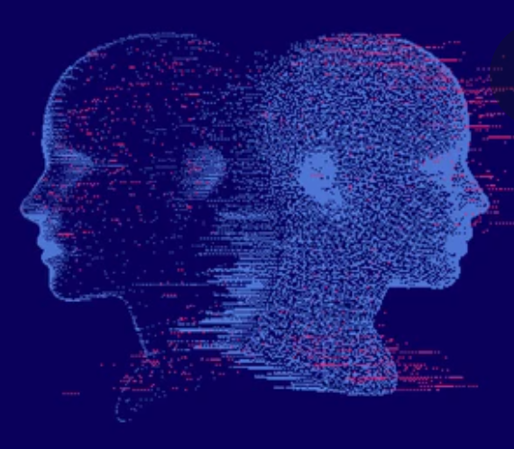

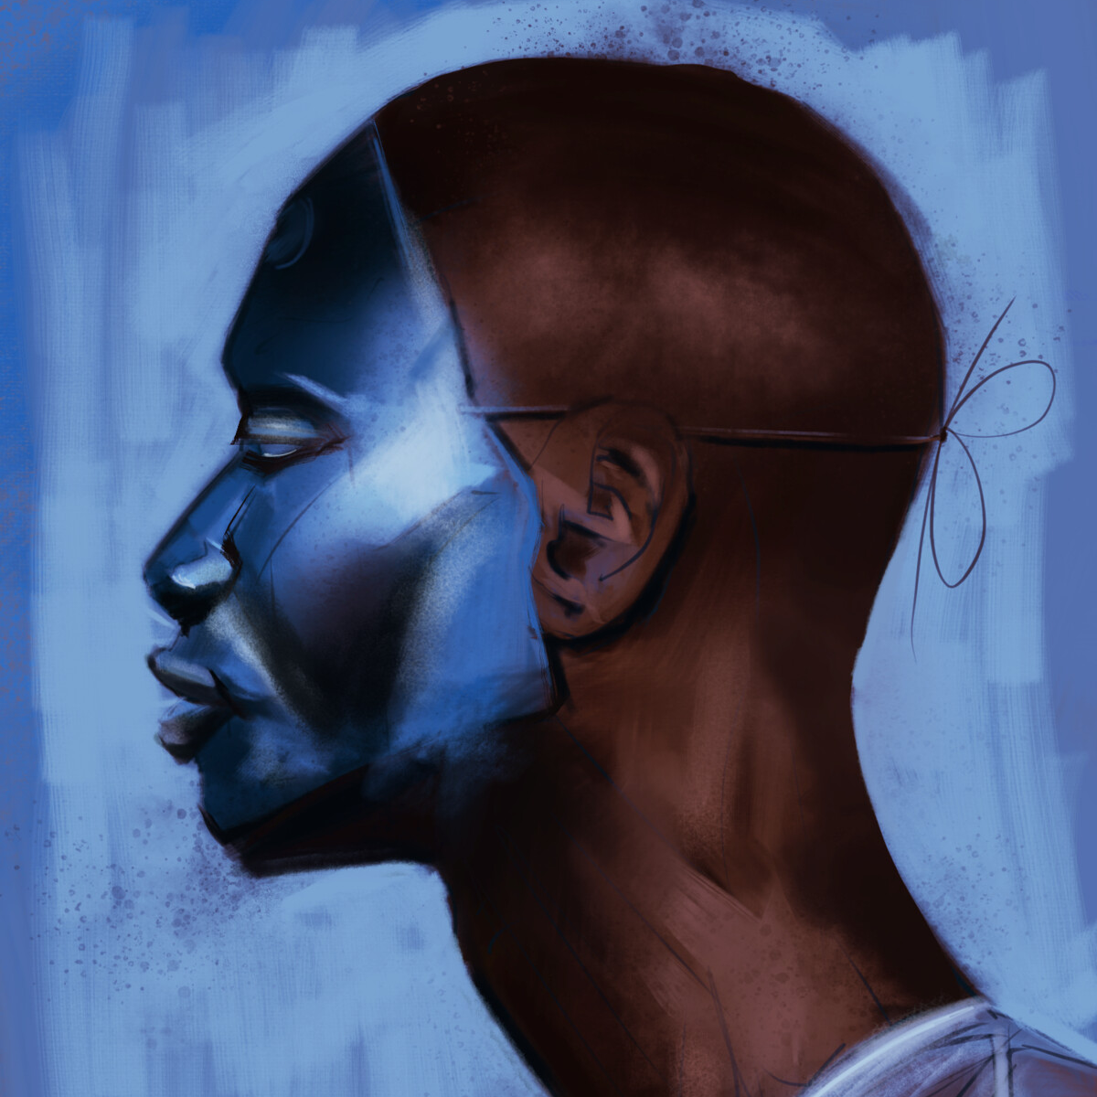

Reasons
Notes:
1. Dissociation between real and internet identities.
2. Inaccessible reactions and expression.
3. Unstructured communities to shape interactions.
4. No lasting consequences.

Slide 6

Proposition

Slide 7

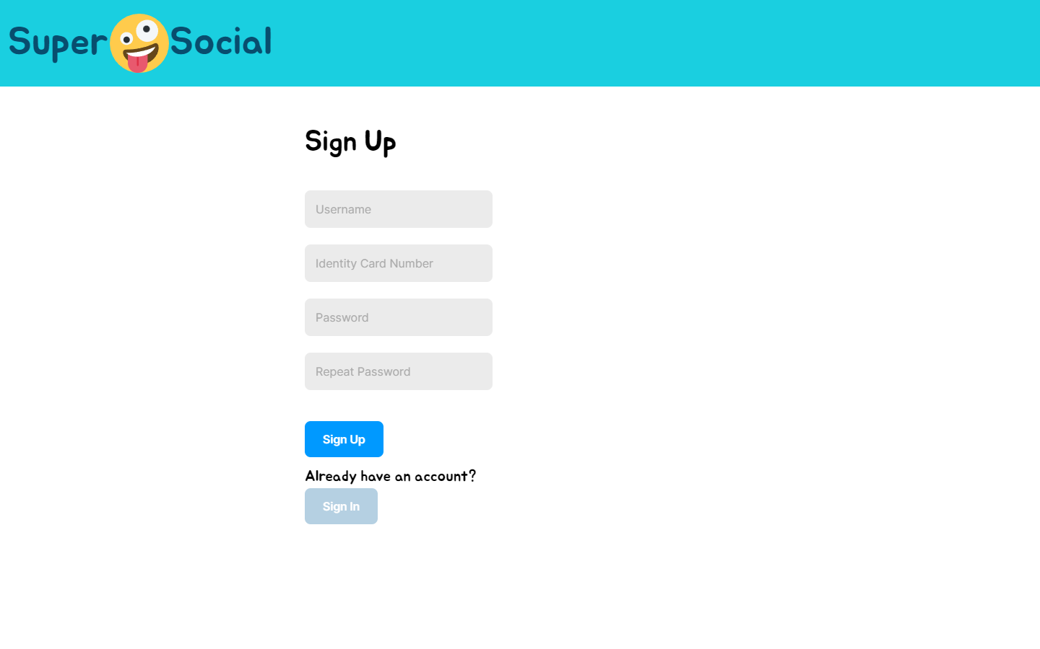
Persistent Digital Identities

Slide 8
Reintroducing Reputation

Slide 9
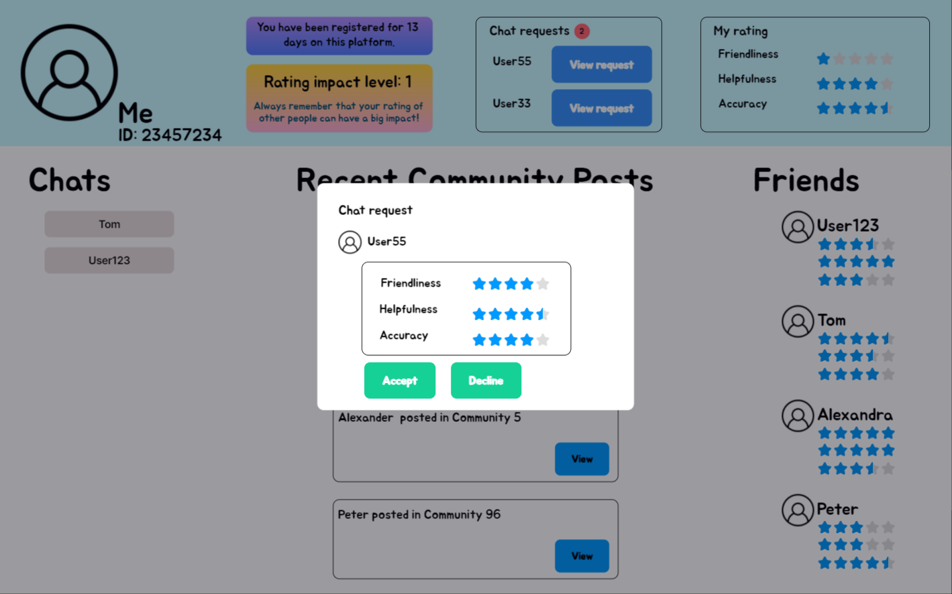
Segmentation

Slide 10
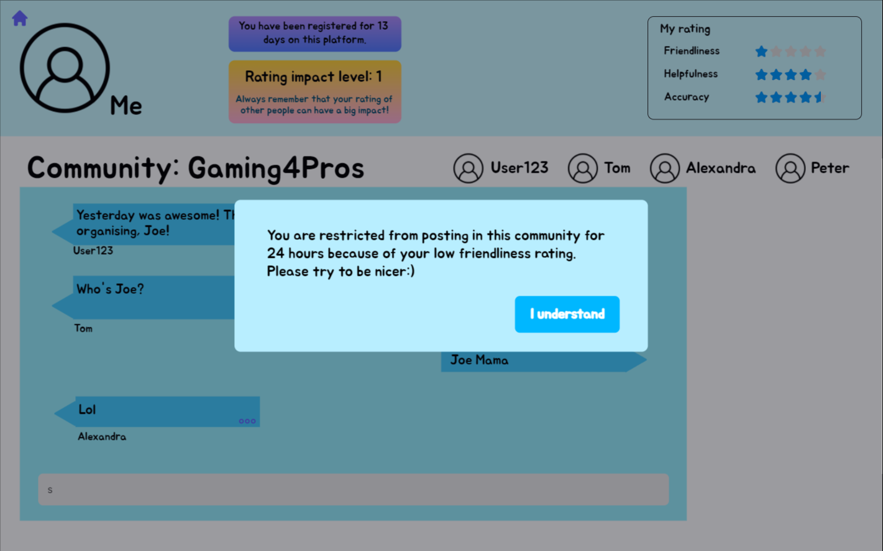
Privileges
and Sliding Window

Slide 11
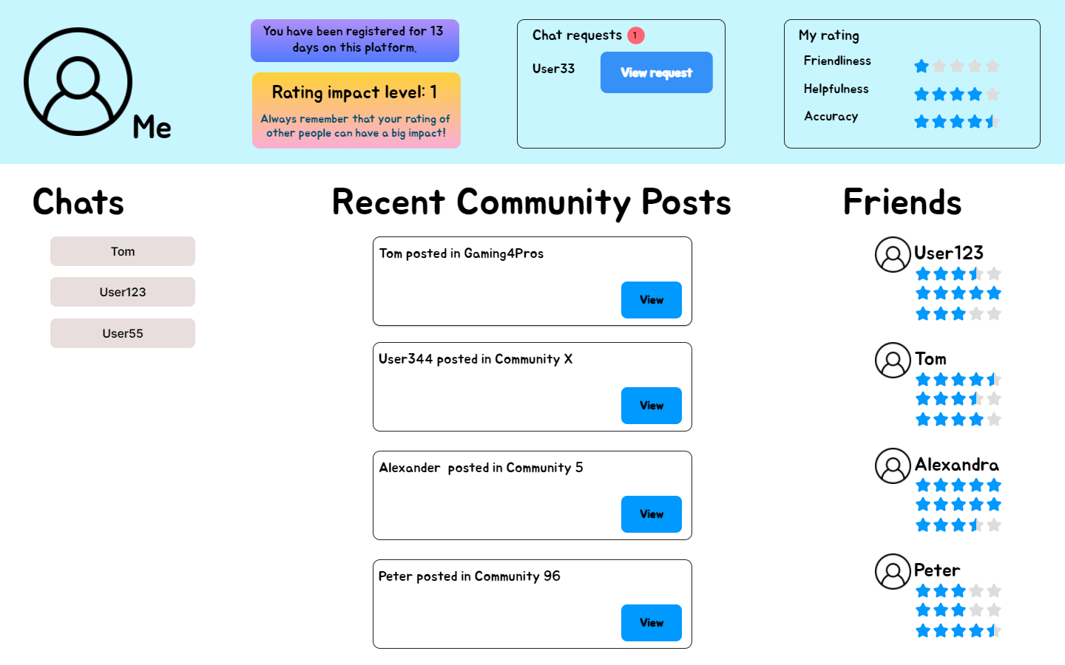
Community based, weighted reputation system

Slide 12
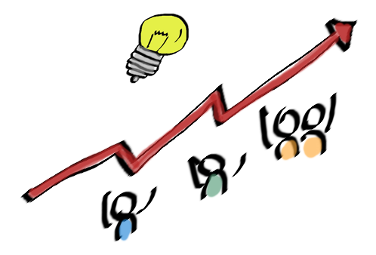
Outcomes

Slide 13

Notes:
Indicators (like friendliness, relevance, accuracy) can help in variety of ways eg: (List is not exhaustive)​
Discouraging toxic behaviour.​
Encourage helpful behaviours.​
Give some information on the reliability of the content.​
Using weights to calculate reputation awards can help against (rare) cases when the community is disproportionately biased. ​

Slide 14


Current implementations
Notes:
Existing implementations:
Facebook does have reactions but without easily accessible background history or statistics for a particular user.​
Stack overflow shows reputation but without giving information about different segments of behavior.​

Slide 15

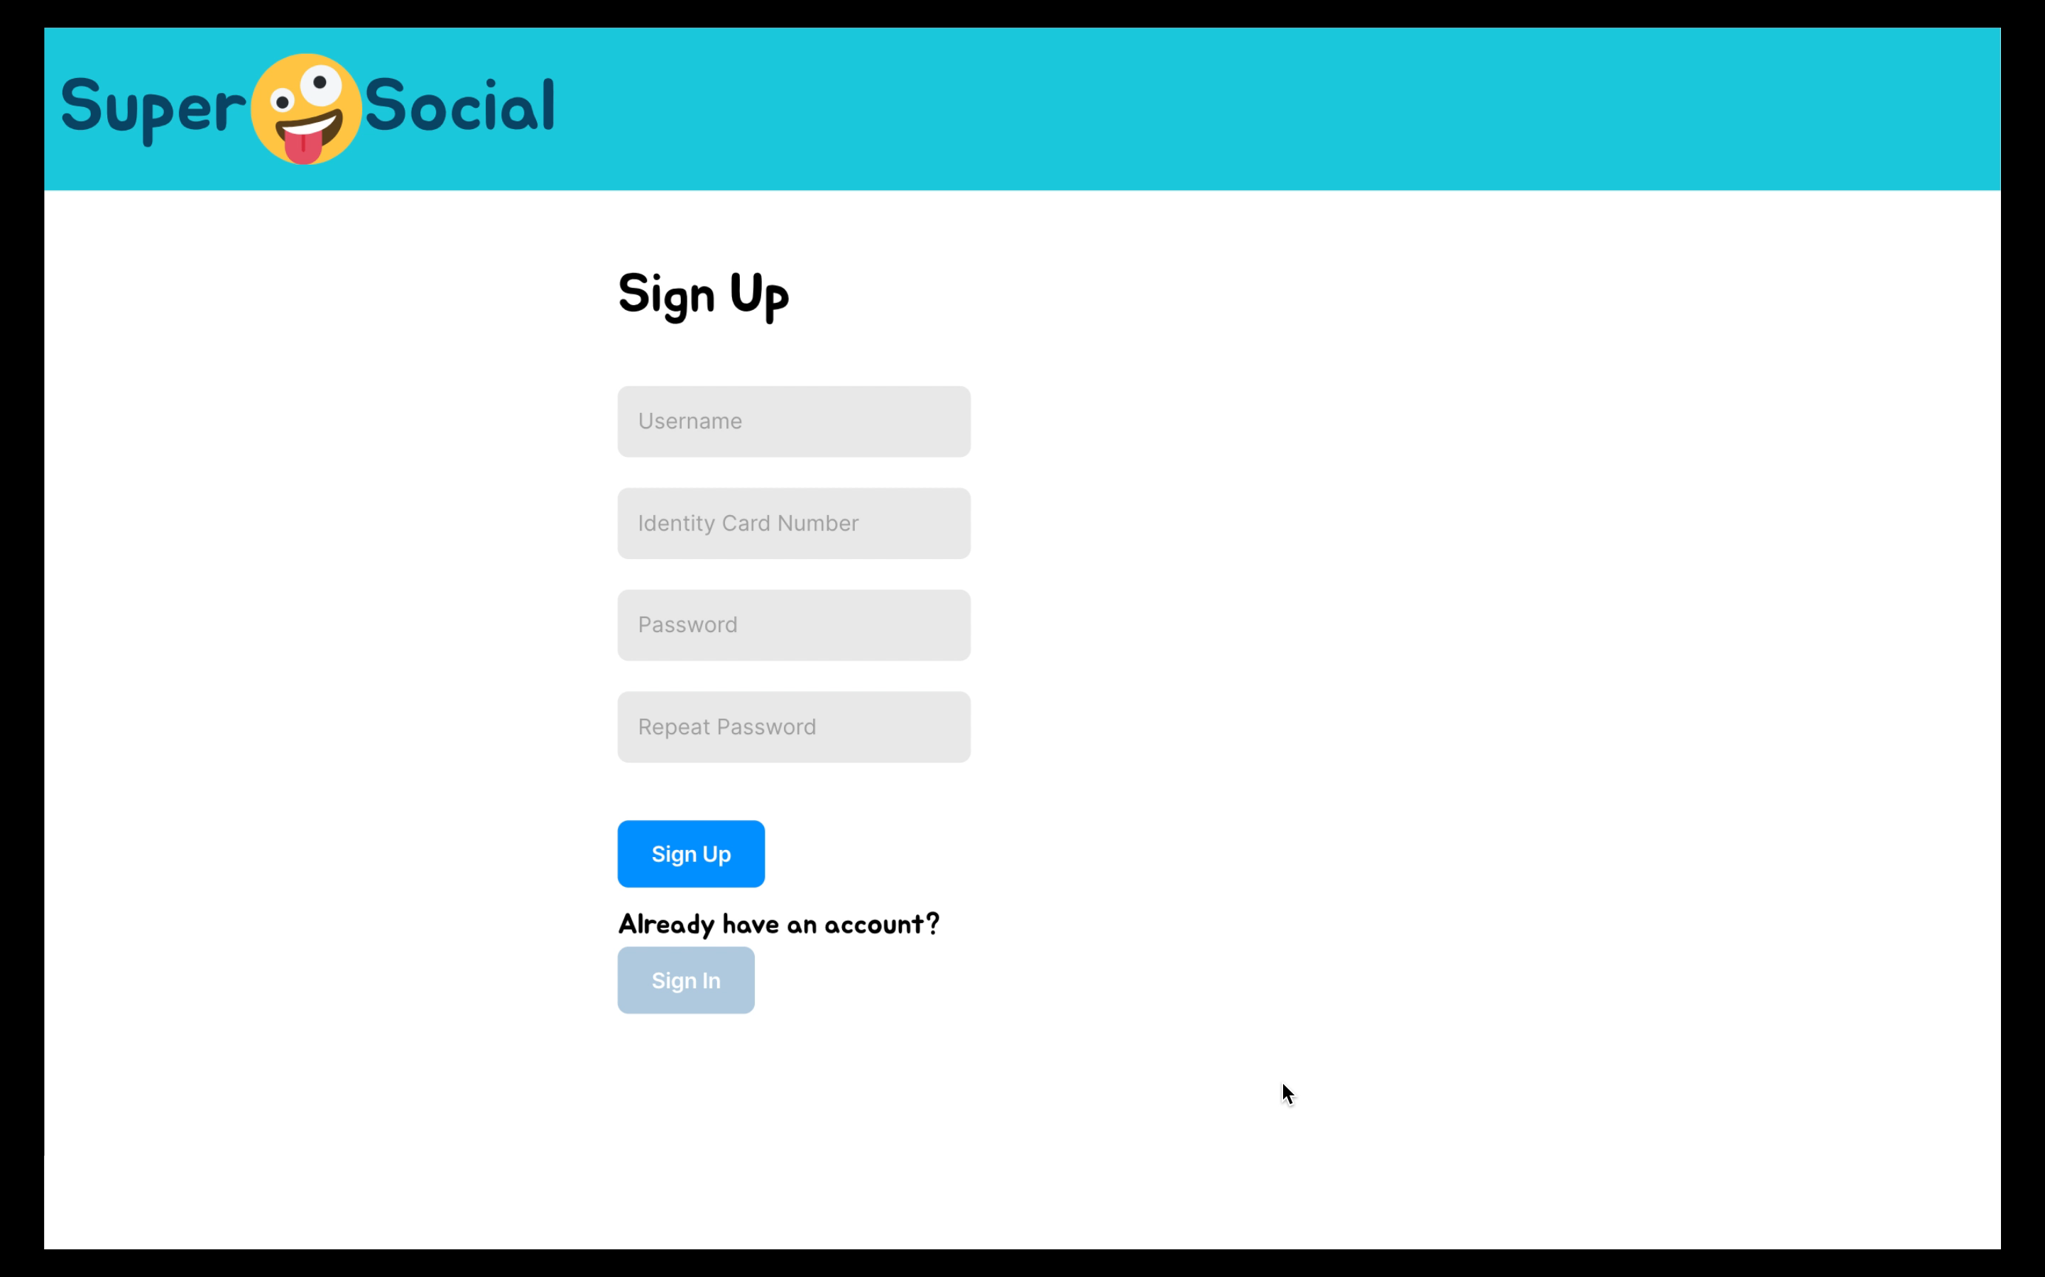
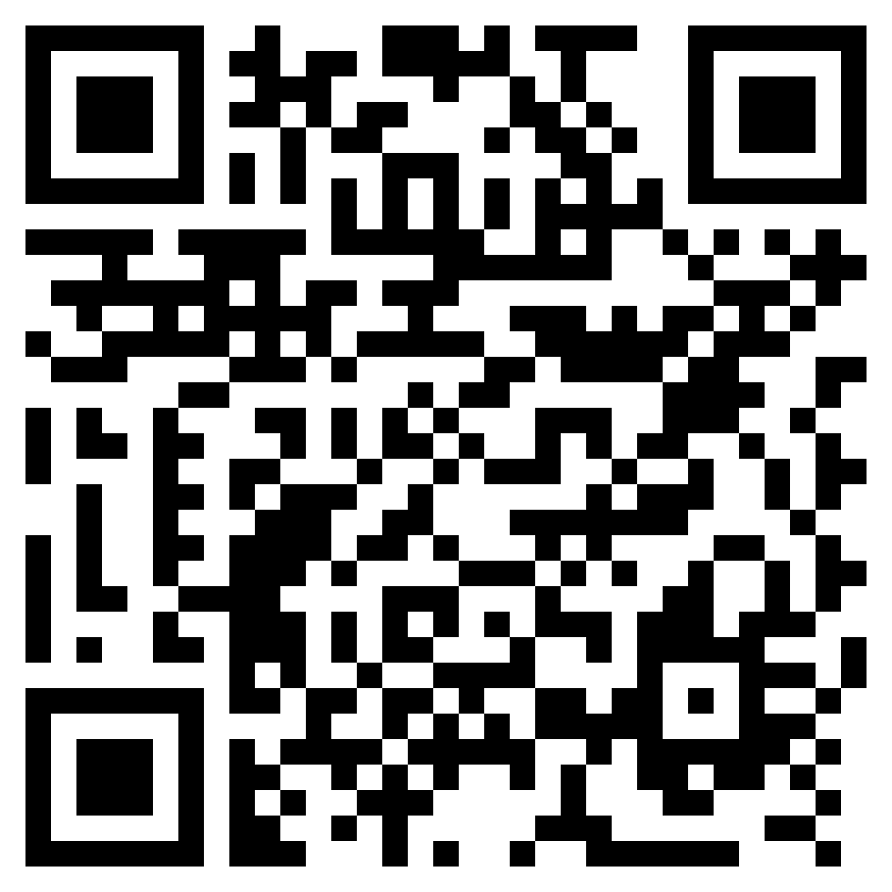
SuperSocial
The community driven social space
Thank You!
Team “Incredibles”: Muhammad Hamza Ali | Ibrahim Siraj Pasha | Jessica Hösl | Jeremiah Agboola

